Slide 1
International relations
Meleg András
Corvinus&ELTE Debate Club
22/03/2021

Slide 2
Structure
Framing
Relevance
Definition
What is IR in Debateland?
Why is IR important?
IR in the real wor
The 3 layers of IR
World order, state interests, people
Tips & Tricks

Slide 3
I) What is IR in debateland?
International relations
What states should do
What states shouldn’t do
Anything, which has at least 1 specific country named in it
Topics with international organisations
Popular topics: US politics, Isreal, Middle-East, European Union, etc.

Slide 4
II) Why is IR important?
war
intervention
International organisation
International problems

Slide 5
III) What is IR in the real world?
Realism - the anarchists
Liberalism – the moralists
Constructivism – the normativist

Slide 6
3 layers in IR debates
World Order / Morality
States’ interest
People of state / area

Slide 7
IV) Examples 1 – talking about iran
Example 1: Domestic Incentives
Don’t say: Iran, they are Arab, right? They probably hate the West!
Good stuff: Iran’s president, Rohani, got elected on a pro-Western platform, so he will probably do nice pro-Western things.
Smashing it: But actually, the person who traditionally has held the most power in Iran is not the president but the Supreme Leader, Khamenei. He’s much more traditional and religious (Muslim cleric). Therefore his incentives, which are more conservative, matter more than Rohani’s.
Example 2: Middle-Eastern Power Play
Don’t say: Iran is Shia? Is that like a tea?
Good stuff: Iran and Saudi Arabia hate each other because most people in Iran are Shia Muslims and most people in Saudi Arabia are Sunni Muslims.
Smashing it: But actually, most Sunnis and Shias can look past their differences like Protestants and Catholics can. However Saudi Arabia’s branch of Sunni Islam, Wahabi-ism, relies on a more aggressive doctrine against Shia Islam, so there is a realistic threat.

Slide 8
3 layers in IR debates
World Order / Morality
States’ interest
People of state / area

Slide 9
IV) Examples 1 – Talking about the US
This House as the US would withdraw its military forces from Syria.
Arg 1 → characterisation: the US has already invested a lot into the Syrian conflict. (bombings, diplomacy, training of local military forces, etc.) → claim: they wouldn’t leave a power vacuum behind → reasoning: Russians, turkish, asad, etc. → impact: the US would use from its local power in the Middle-East, if they walk out.
Further backup: they lose power for either
1) because breaks the norm that he dictates the pace of world politics
2) lose power, because other nations can shape the region without US’s supervision

Slide 10
3 layers in IR debates
World Order / Morality
States’ interest
People of state / area

Slide 11
IV) Examples 1 - Morality
THIS HOUSE WOULD BOYCOTT SPORT EVENTS HELD IN COUNTRIES WITH POOR HUMAN RIGHTS RECORDS

Slide 12
3 layers in IR debates
World Order / Morality
States’ interest
People of state / area

Slide 13
War
1) How big a threat is a country? How credible is that threat? Or why is it not really a threat?
2) Why is a threat enough to justify an attack? Or why is it not?
3) Who is going to attack?
4) Is this attack going to be effective: will it stop the threat, or decrease it, or will it be counterproductive
World Order / Morality
States’ interest
People of state / area

Slide 14
IV) Examples
THIS HOUSE SUPPORTS NUCLEAR WEAPONS

Slide 15
V) Tips & Tricks – the role of facts
When the fact can be expected to be widely known by an ordinary intelligent person
When the fact is superficially plausible and explained in considerable and persuasive detail.
When the fact is primarily being use to not ‘prove’ an argument but to illustrate (i.e. make clearer) the speaker’s meaning
When the fact is superficially plausible and only being used to support the plausibility of another claim
When the fact is explicitly accepted by both sides of the debate.

Slide 16
FACT CHEATSHEET
ORDINARY
DETAIL
ILLUSTRATE
SUPPORT
ACCEPTED

Slide 17
V) Tips & Tricks – Building knowledge
Read
Look at maps
Country profiles
Do it with friends
Research

Slide 18
V) Tips & Tricks – „I ain’t know poop”
Go
balls
Deep

Slide 19
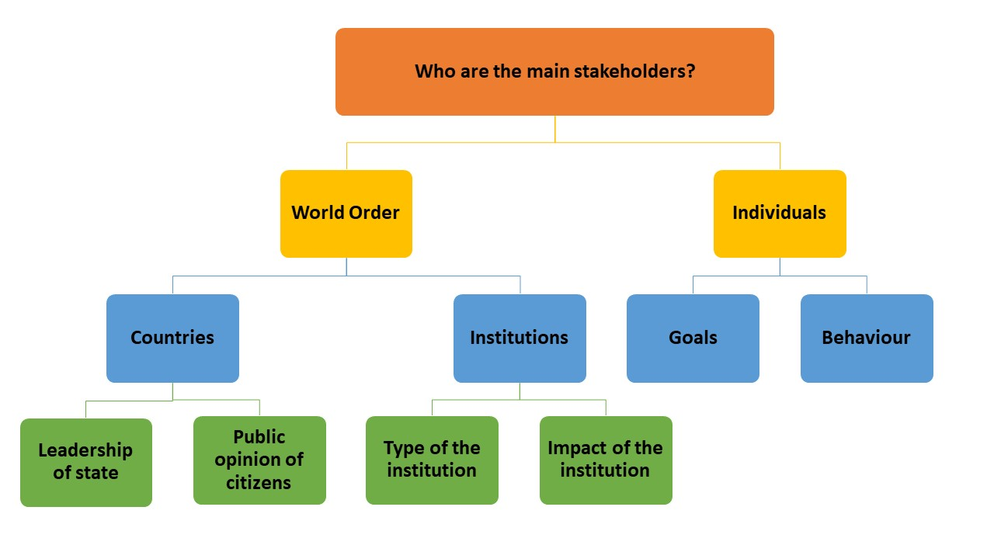

Slide 20
IX) Practice
Form groups of four! ( you have 30 seconds for this task)
Each of you choose one topic from the following four: (30 sec)
1)THW cancel the Tokyo Olympics
2) TH as the Australian government should prioritise its relationships with China, over its relationships with the US, in its foreign policy
3) TH, as Russia, regrets annecting the Crimean peninsula!
4) This House Would leave the United Nations!
Think about arguments, based on the workshop! (3 minutes)
All of you present their arguments and ideas in 1-2 minutes to the group (4x2 minutes)

Slide 21
X) Summary

Slide 22
II) Why IR is important?
war
intervention
International organisation
International problems

Slide 23
III) What is IR in the real world?
Realism - the anarchists
Liberalism – the moralists
Constructivism – the normativist

Slide 24
3 layers in IR debates
World Order / Morality
States’ interest
People of state / area

Slide 25
V) Tips & Tricks – „I ain’t know poop”
Go
balls
Deep

Slide 26
References
Based on a text by Jonathan Leader Maynard
Based on a presentation by Olivia Sundberg Diez
Based on CEU Debate Society’s 07/02/2018 meeting
Original presentation of the workshop: April 8th 2019

Slide 27
XI) Debate
Please form teams!
OG: Bandi, Sandu
OO:, Felix, Peti
CG: Ádám
CO: Ruben, Gyuri

Slide 28
And the motion for today is...
TH

